Slide 1
Employee Compensation
Pub 4012, Tab D
Pub 17
(Federal 1040-Line 7)
(NJ 1040-Line 14)
Notes:
1

Slide 2
Employee Compensation
Types of employee compensation:
Wages, salaries, tips, severance pay, bonuses, & commissions
Cash, goods & services, awards, & taxable benefits
Pre-retirement disability payments
Employee compensation usually reported on Form W-2, Wage & Tax Statement
All taxable, even if not reported on W-2
Household employee income entered on 1040 Worksheet 1
Other types of employee compensation not on W-2 added to Wages line in TW using scratch pad
Pre-retirement disability reported on 1099-R
Notes:
Note: Pre- Retirement Disability payment is reported on 1040 line 7
2

Slide 3
Federal Treatment of Disability Income
Disabled (TP) who receives 1099-R
If TP is under minimum retirement age (for their company)
1099-R Box 7, Code 3 (disability distribution)
On TW 1099-R screen, line below Box 7, check box that reads “disability & TP is disabled.”
TW will include amount on 1040 Line 7 Wages
If TP is over minimum retirement age of their company
1099R Box 7, Code 3 (disability distribution)
TW puts income on 1040 line 16 Pension/Annuity Income
Notes:
If TP is disabled but over minimum retirement age, DO NOT populate the box on the 1099R screen indicating disabled, because the payment is treated as a Pension

Slide 4
NJ Treatment of Disability Income
Key determinant for treatment of 1099-R disability income on NJ return is person’s age
Disability income on NJ return taxable if age is 65 or over (treated as a regular pension)
Disability income on NJ return not taxable if age less than 65
If taxpayer’s company minimum retirement age is below 65 and taxpayer is between that age and 65
Adjustment required to NJ pension Line 19 using scratch pad to remove from taxable pension and treat as regular wages in NJ
Notes:
For Federal purposes, determinant for treatment of disability income is company’s minimum retirement age
For State purposes, treatment is determined as on this slide

Slide 5
NJ Withholdings (Unemployment, Disability, Family Leave)
NJ taxes withheld from income for unemployment, disability and family leave insurance
Deductible on Federal Sch A unless a private plan
UI/WF/SWF(State Unemployment Insurance)
All included in NJSUI in TaxWise (combine together if listed separately)
UI - Unemployment Insurance
WF – Workforce Fund
SWF – Supplemental Workforce Fund
Maximum amount changes each year
DI(State Disability Insurance)
NJSDI in TaxWise
Maximum amount changes each year
FLI(Family Leave Insurance)
NJFLI in TaxWise
Maximum amount changes each year
Notes:
W-2 may have NJFLI, NJUI, NJDI all in box 14 or elsewhere on W-2
Must always enter it on TW in box 14
Must ensure that amount is put next to correct label; may be in a different order on W-2 than in TW

Slide 6
Scholarships & Fellowships
Degree Candidates only:
Amounts received for tuition, fees & books are not taxable
Amounts received for supplies & equipment are not taxable, if required
Amounts received for room, board & travel are taxable & reported on 1040 Line 7 Wages
If no W-2, enter data on 1040 Income Worksheet 1 in TW
Notes:
6

Slide 7
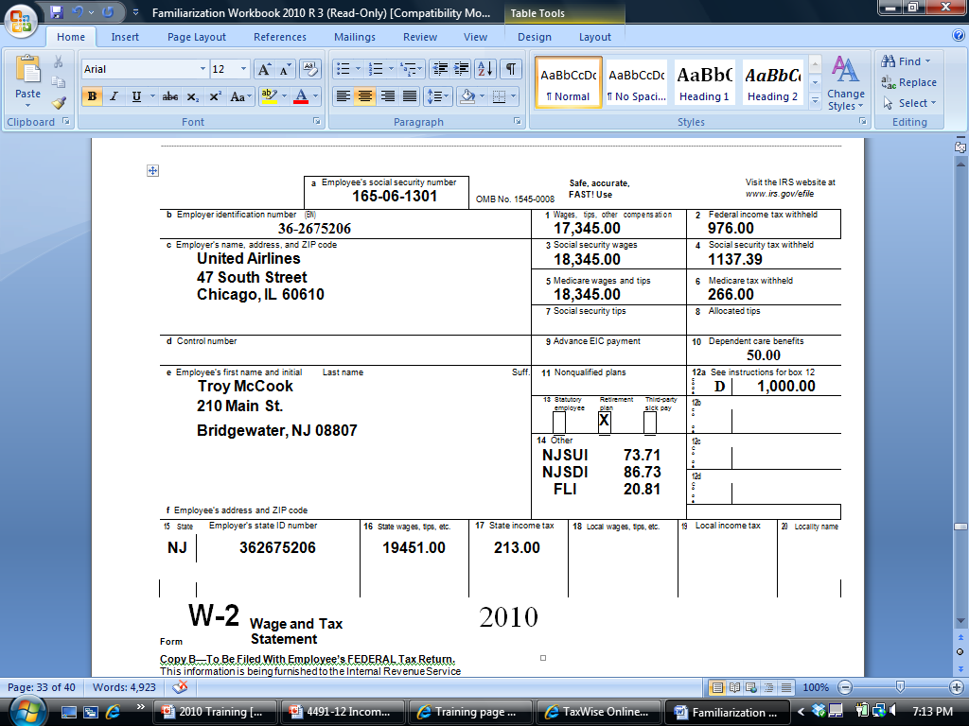
Sample W-2
Federal wages different than SS/Medicare wages
123-06-1301
Dependent care
Douglas Davis
210 Main Street
Bridgewater, NJ 08807
DD
6,350.00
NJSUI 82.67
NJSDI 73.91
NJFLI 19.45
401k Contribution
Box 12 Code DD - Amount for Employer-Provided Health Insurance; not taxable
NJ Wages different than Federal wages
Notes:
This is the source document a working client will present for their wages
A W-2 can be multiple pages
Some interesting things on this W-2:
Federal wages are different than Social Security & Medicare wages
Employee received Dependent Care benefits from employer in Box 10
Employee made a contribution to a 401k plan, indicated by code in Box 12. Notice that amount contributed to 401k pre-tax is difference between Federal wages & Social Security/Medicare wages
NJ box 16 state wages are different than Federal box 1. There is an amount that is pre-tax federal but after- tax NJ. Need to see pay stub to determine what it is. Important if it is medical
Box 12 code DD – shows amount for employer-provided health insurance
Not taxable
Just enter into TW Box 12
7

Slide 8
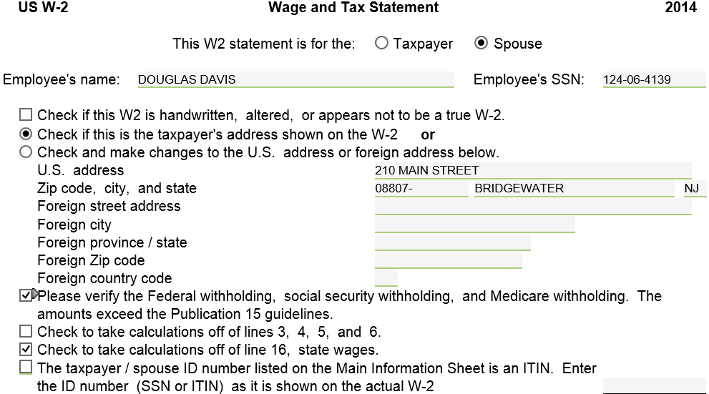
TW W-2 Screen
Verify or change address
Verify withholdings
Override Medicare & SS wages/ taxes
Override states wages
Notes:
Pull up TW W-2 screen
Link from Line 7 on 1040 Page 1
Click on right arrow, click on “Link to another form,” click on W2 Wage & Tax Statement OR
F9, click on W2 Wage & Tax Statement
Go directly to W-2 screen by clicking on W2 in Forms Tree
TW screen must match exact info from printed W-2 form
Check whether W-2 is for taxpayer or spouse
Check appropriate box for address
If pre-populated address from Main Info screen is same as address on W-2 form, click on box on Line 2
If address on W-2 form is different, click on box on Line 3, which allows you to override Main Info screen address; then enter address exactly as it appears on W-2
If box “Please verify the Federal withholding, social security withholding, and Medicare withholding. The amounts exceed the Publication 15 guidelines” is in red, it indicates that amount of Federal tax withheld is out of the norm. Verify that Boxes 1-6 are correctly copied from the W-2 and check the box
This is an anti-fraud measure, but may happen legitimately if client has multiple jobs
8

Slide 9
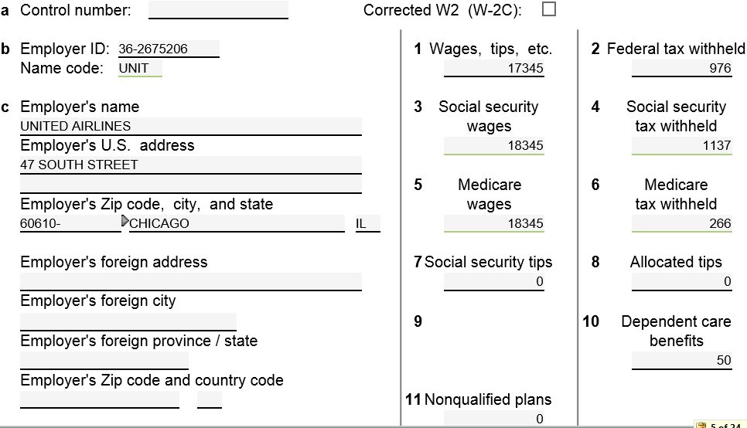
TW W-2 Screen
(cont'd)
Enter
Enter EIN; TW
may bring up name
& address
TW populates
Verify/enter
name & address
Notes:
Enter Employer ID & Employer Name & Address (if they don’t come up automatically from entering employer ID - EIN)
Enter Zip Code, & TW will populate city & state. If these fields come up automatically and are red, verify the fields are correct and take the red out using F-3 or Ctrl-space
Enter Wages in Box 1
TW will automatically populate SS & Medicare wages/tax withheld in Boxes 3, 4, 5, 6
When Federal wages not = SS or Medicare wages, it is often because of what is in box 12. Enter contents of box 12 next
If amounts on W-2 are still different after entering Box 12, must check box at top of screen “Check to take calculations off of lines 3, 4, 5, 6” before TW will allow you to enter #s from W-2
Enter any other #s from W-2 Boxes 2, 7-12
TW will include Allocated Tips from Box 8 in Wages (1040 Line 7)
TW will use Dependent Care Benefits from Box 10 in calculating Credit for Child & Dependent Care Expenses on Form 2441 Part III Line 14
9

Slide 10
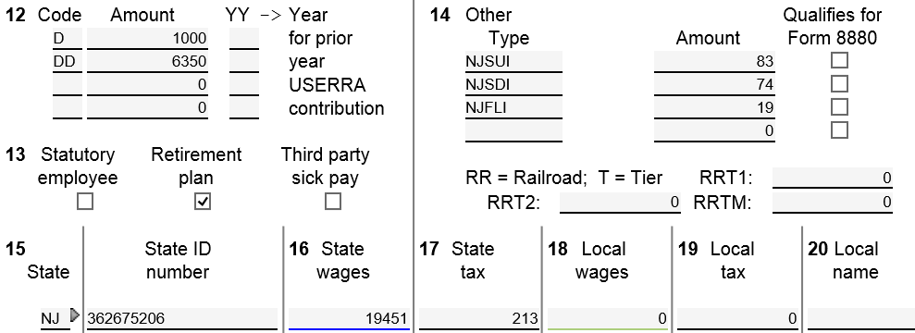
TW W-2 Screen
Enter; TW recalculates Boxes 3-6 ,
If necessary
(cont'd)
Preset labels
flow to Sch A
Enter
next
to proper
label
TW transfers from Box 1; check box at top of screen to override
Notes:
Enter NJSUI (Unemployment), NJSDI (Disability), & NJFLI (Family Medical Leave) amounts in TW Box 14 (even if they are someplace else on W-2)
On some W-2s, WF or SWF (Work Force Development – a portion of Unemployment NJSUI) is separated from Unemployment. When entering in TW, add WF/SWF & Unemployment together & enter in box 14 under NJSUI
If exact headings NJSDI, NJSUI, & NJFLI are used on W-2 screen, TW will include these amounts in State/Local Taxes you paid on Sch A Itemized Deductions
Private plans, indicated by PP#, cannot be claimed on Sch A. Therefore, must change heading to include letters PP (e.g. – NJSDIPP) so that amount does not flow through to Sch A.
Entries under non-standard names will also not flow through to NJ Form 2450 for excess contributions to unemployment, disability, or family leave. The amounts would have to be added manually to Form 2450 via a scratch pad
If other entries in this box, such as 414h, enter on TW screen. They do not flow through to Sch A
If more items are in box 14 of the W-2 than there is room for on the TW W-2, combine them together and enter on the open line
TW automatically enters State ID in Box 15 (based on state on Main Info screen) & State Wages in Box 16 (based on Federal wages).
If State Wages on W-2 is different than TW populated, must check box at top of screen “Check to take calculations off of line 16 state wages” before TW will allow you to enter # from W-2
Enter State ID #
Enter State Tax Withheld from Box 17
10

Slide 11
W-2 Screen - TW Tips
TW data must exactly match W-2 form
(Except for Box 14 NJ special taxes; use pre-populated TW labels)
Enter all data fields from W-2
Remember to check taxpayer or spouse box
Verify taxpayer address on W-2
If address is correct, click on Line 2 at top of screen
If address on W-2 form is different, click on Line 3 & enter address exactly as it appears on W-2
Enter wages & subsequent information in boxes 1 thru 20
Notes:
11

Slide 12
W-2 Screen - TW Tips
(cont'd)
SS & Medicare wages/tax withheld (Boxes 3, 4, 5, 6) automatically calculate. If different than W-2 form, enter boxes 7-12 next. If still different, check box at top of screen “Check to take calculations off of lines 3, 4, 5, 6” & then enter data from W-2
Enter NJSUI (Unemployment), NJSDI (Disability), & NJFLI (Family Medical Leave) amounts in TW Box 14 (may be located someplace else on W-2)
If UI/WF/SWF listed separately, add together and enter as NJSUI
Notes:
12

Slide 13
W-2 Screen - TW Tips
(cont'd)
Box 14 - Must use exact headings NJSUI, NJSDI, and NJFLI on TaxWise screen so amounts flow through to Schedule A State and Local Taxes Line 5a (no matter what is on W-2)
If Private Plan for any of these, indicated by PP#, cannot claim on Schedule A. Change heading to include PP at end (e.g.-NJSDIPP) so that amount does not flow through to Line 5a. May also need to adjust NJ-2450 if more than one W-2
If other entries on W-2 (e.g.-414H), enter in Box 14, but they do not flow through to Schedule A. If multiple other entries combine them together. There is only one available line left and you cannot add a scratch pad here
Notes:
13

Slide 14
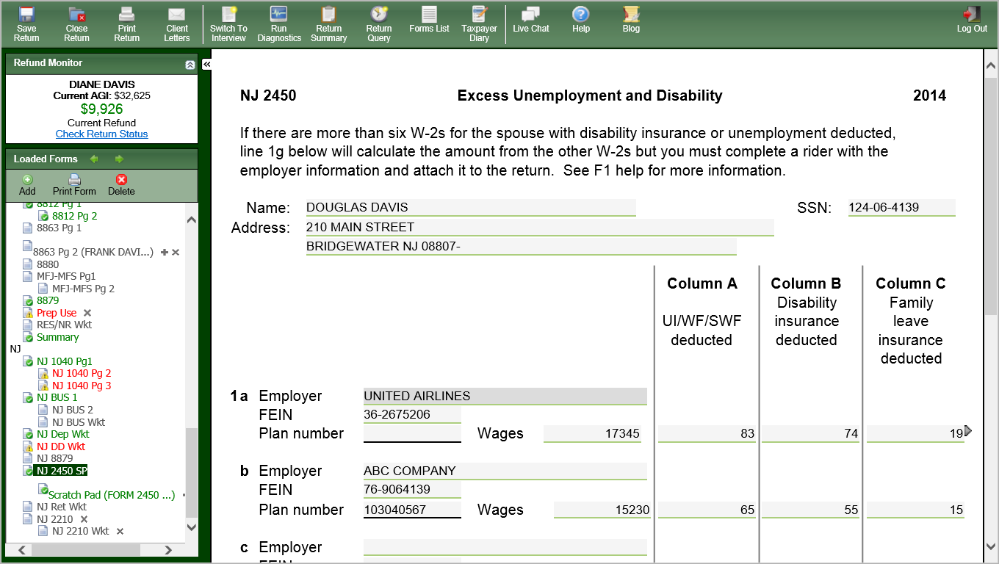
TW Excess NJSUI, NJSDI, NJFLI: NJ Form 2450 – Private Plan Disability
After manually adding Private Plan (PP) # & amount. Use scratch pad to document
Notes:
When NJSUI, DI or FLI exceed maximum(usually because TP has multiple W-2s), form NJ 2450 will be added in tree. Taxpayer is eligible to get the excess collected back.
Private Plan disability needs to be added to NJ 2450, and is transferred to NJ1040 lines 53

Slide 15
W-2 Screen - TW Tips
(cont'd)
If State Wages on W-2 are different than TW populated, must check box at top of screen “Check to take calculations off of line 16 state wages” & then enter data
Notes:
15

Slide 16
Tip Income
Employees must report tips collected to employer (other than months with less than $20)
Employer reports those on W-2 as Social Security tips in Box 7 and takes out Social Security and Medicare taxes (Boxes 4 & 6) for reported tips
Employer legally must also account for estimated unreported tips (calculated from the difference between the reported tips and a percentage of their food & drink sales) That difference must be allocated between all employees, and each employee’s share is reported on the W-2 as Allocated Tips in Box 8
See Taxprep4free.org for special topic Reporting Tip Income

Slide 17
Tip Income
(cont’d)
Tips that are less than $20 per month do not need to be reported to the employer. However, the employee has to report them as income if there are no allocated tips on W-2
The taxpayer must pay Social Security and Medicare Taxes on all Allocated Tips (Box 8 of W-2) and any unreported tips (other than the months that were less than $20 and not reported)
Form 4137 is used to calculate these
See TaxPrep4Free.org Preparer page for special topic document “Reporting Tip Income” for details

